Slide 1
ALL ABOUT ME
BY ALECIA

Slide 2
MY NAME IS
ALECIA TOWNS

Slide 3
MY FAVORITE COLOR
IS BLUE

Slide 4
MY HOBBIES
CHEERING AND DANCING

Slide 5
i like to go
Places with my mom

Slide 6
MY FAVORITE SUBJECT
MATH READING

Slide 7
MY FAVORITE SPORT
BASKETBALL

Slide 8
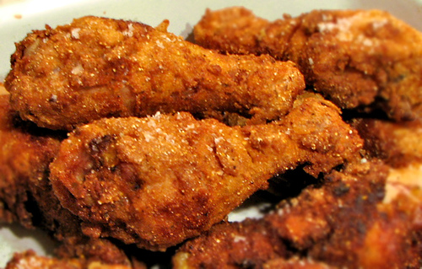
MY FAVORITE FOOD
CHICKEN

Slide 9
MY FAVORITE TV SHOW
SPONGEBOB

Slide 10
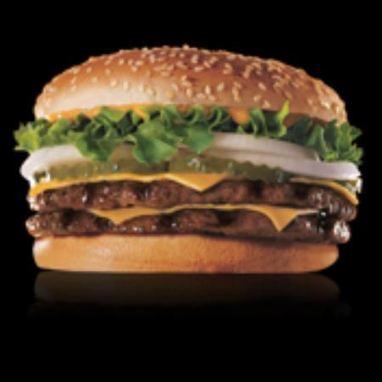
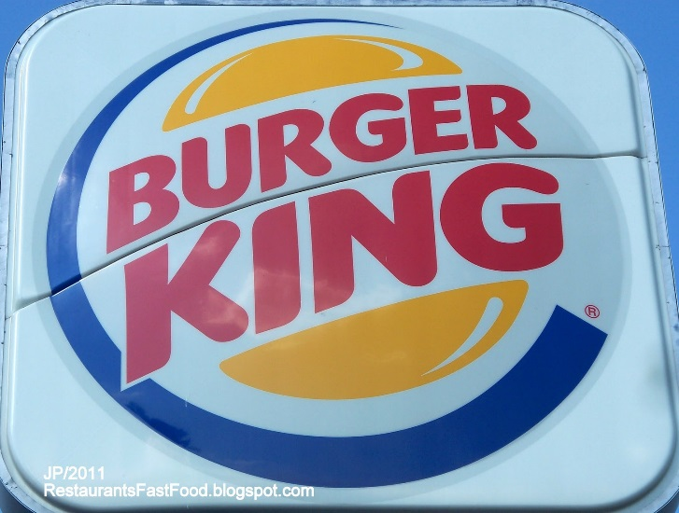
MY FAVORITE RESTRAUNT
IS BURGER KING

Slide 11
MY FAVORITE BOOK
THE PASSAGFE JUSTICE CROIN

Slide 12
MY FAVORITE SINGER AND RAPPER
NICKI MINAJ

Slide 13
MY FAMILY
1 sister 2 brothers

Slide 14
MY FAVORITE ACTRESS
ARIANA GRANDA

Slide 15
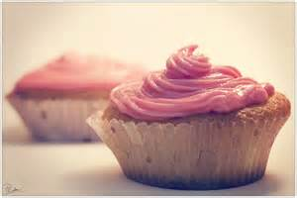
MY FAVORITE DESERT
CUPCAKE AND ICECREAM

Slide 16
I like to shop
At the mall

Slide 17
My future plans
I want to go to college.

Slide 18
My FAVORITE TEACHER IS
MRS.MCNEIL

Slide 19
My favorite movie twilight
Because it a good movie

Slide 20
THE END
OF THE STORY

